Slide 1
Indigenous Flight Control Computer Prototype Development (FCC)
Prepared By: Amna Arshad Khan
Date: June,25,2024

Slide 2
Indigenous Avionics Suite Prototype Development
Phase - 3
Power Module
Batteries
Telemetry
Data logging
Flight Control Computer
(FCC)
RC Controller
Phase - 1
Flaps
Servo drive Assembly
Air data Boom
Elevator
Phase - 2
INS Gyro/Accel
Rudder
GPS
Ailerons
Altimeter
Camera
SENSORS REQUIRED FOR TEST FLIGHTS
Ground proximity radar
Control Engine Unit
Engine
Miscellaneous Avionics
Stain gauges
Thermistor

Slide 3
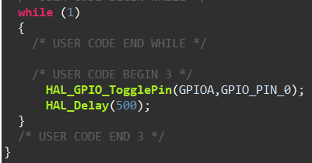
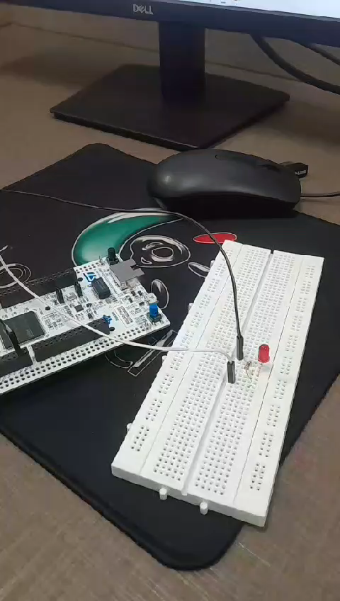
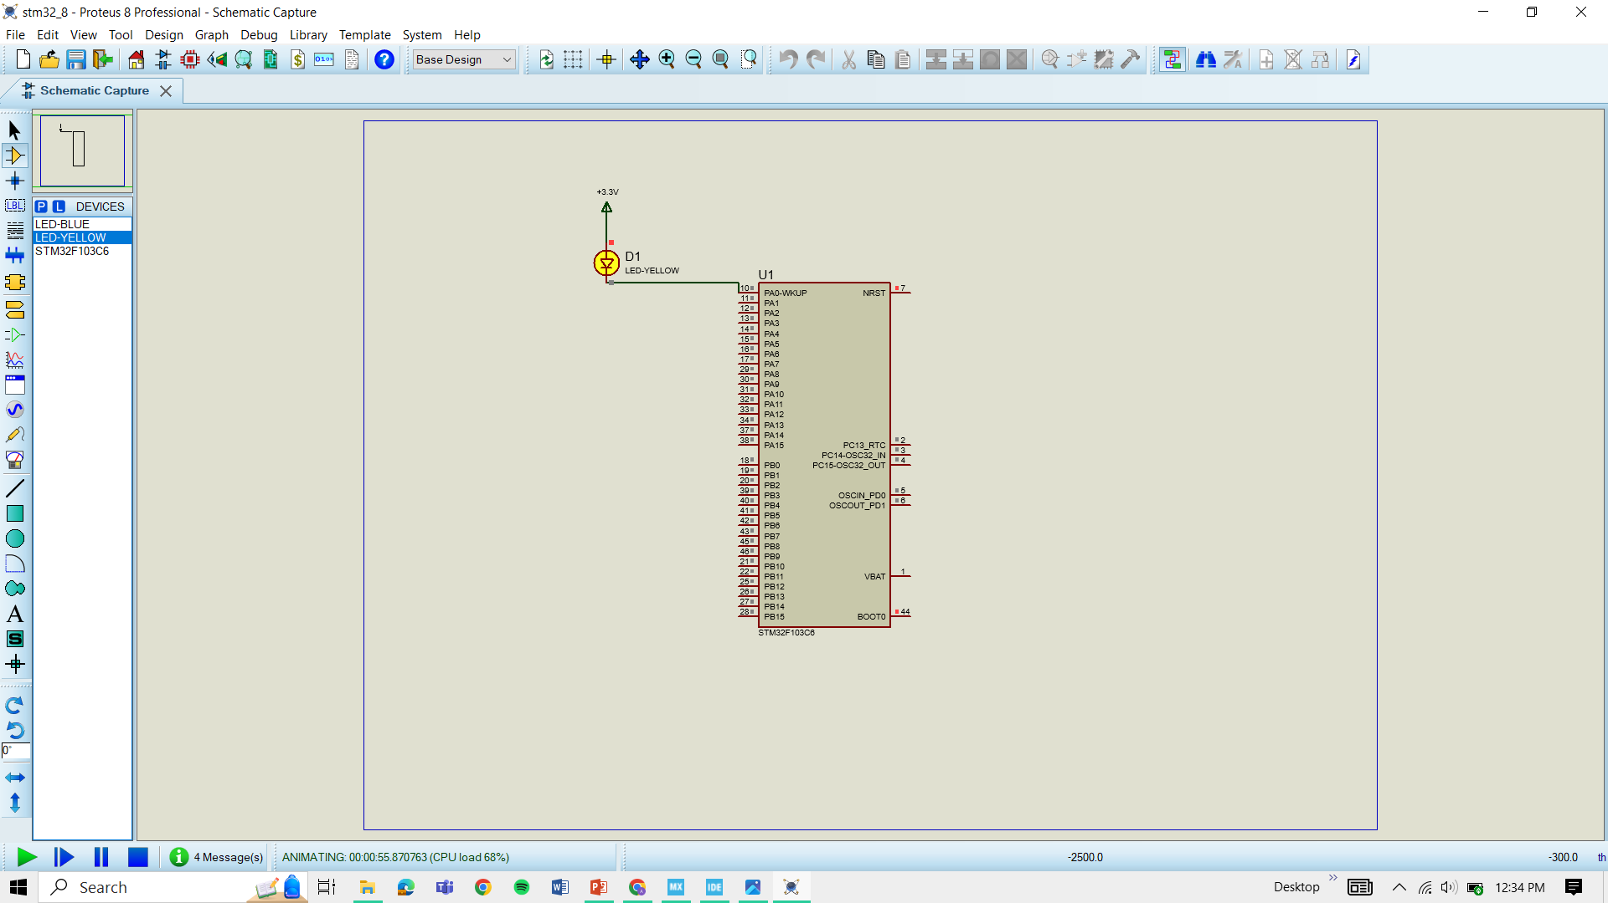
GPIO DETAILS
STM32IDE AND CUBEMX interface understanding (LED Blinking testing).

Slide 4
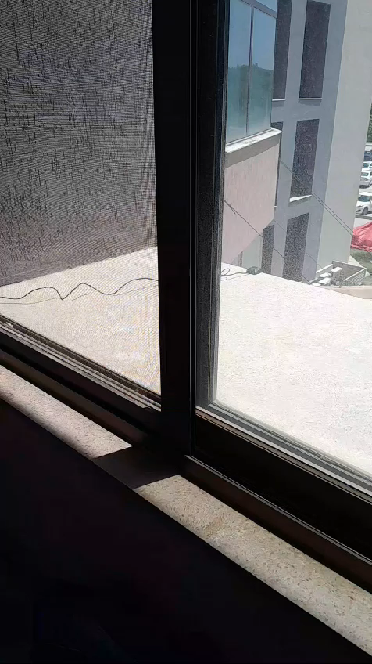
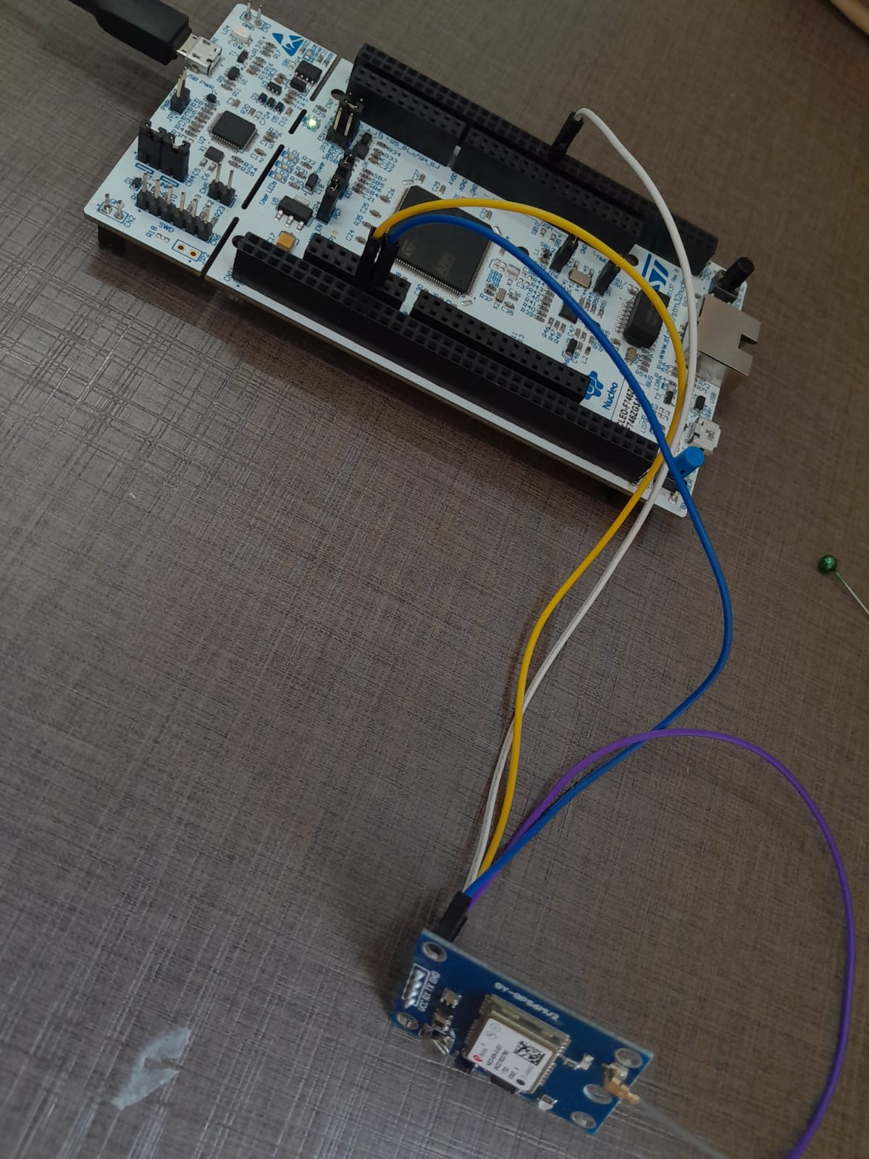
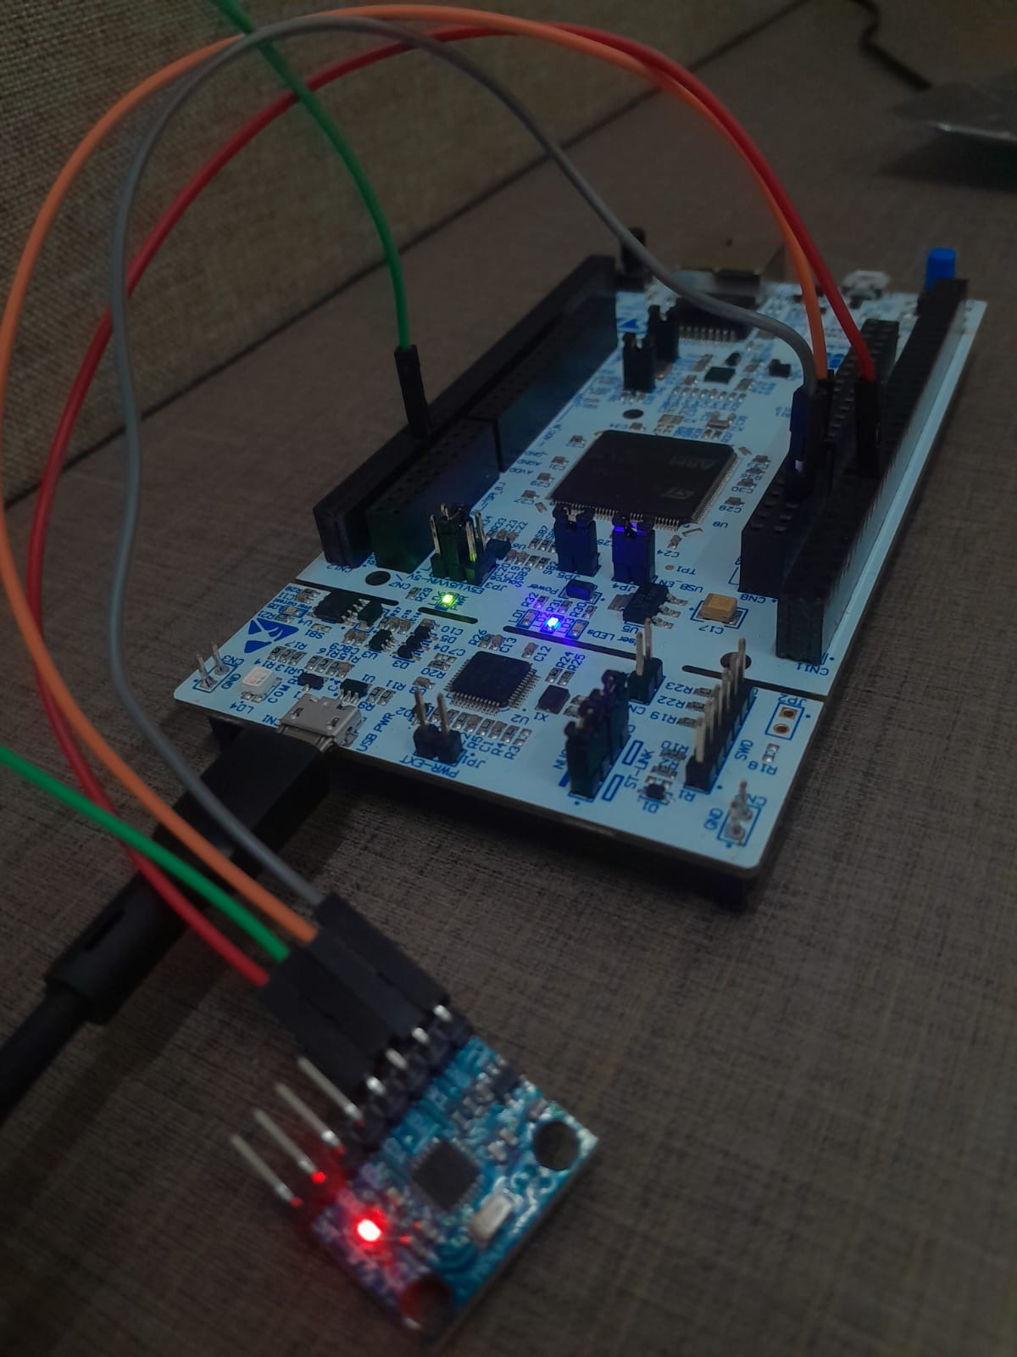
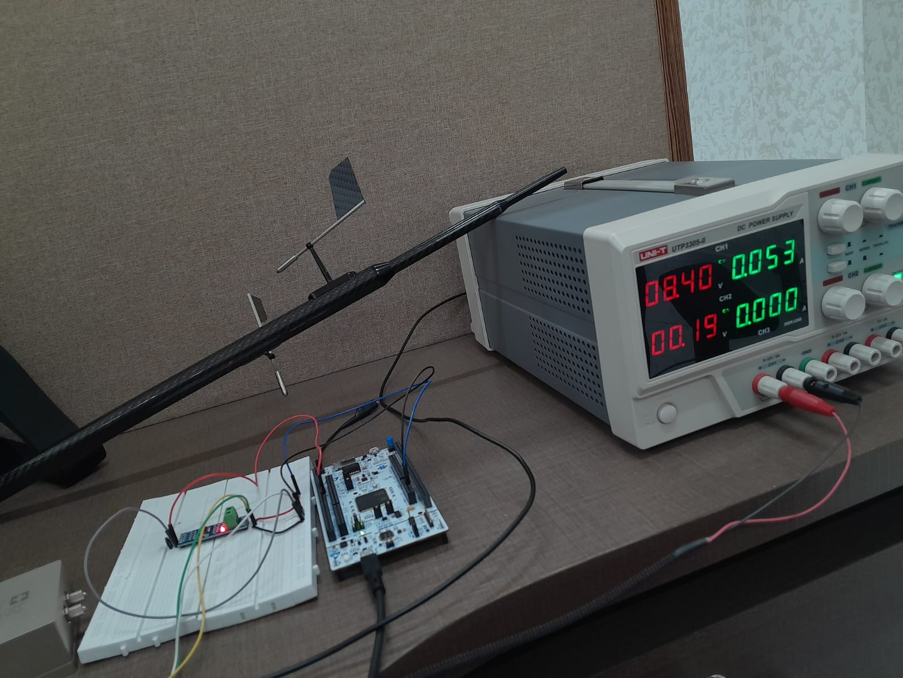
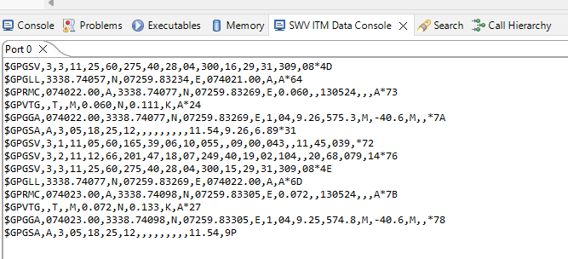
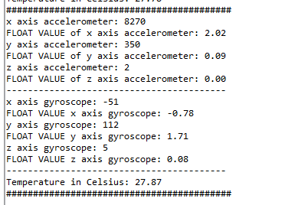
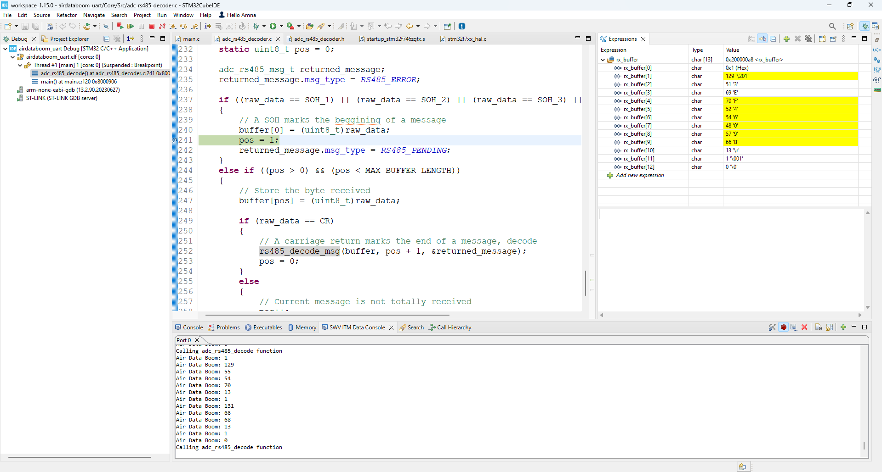
WORK DONE
Testing of GPS
Integration of GPS
Testing of MPU6050
Integration of Air data boom

Slide 5
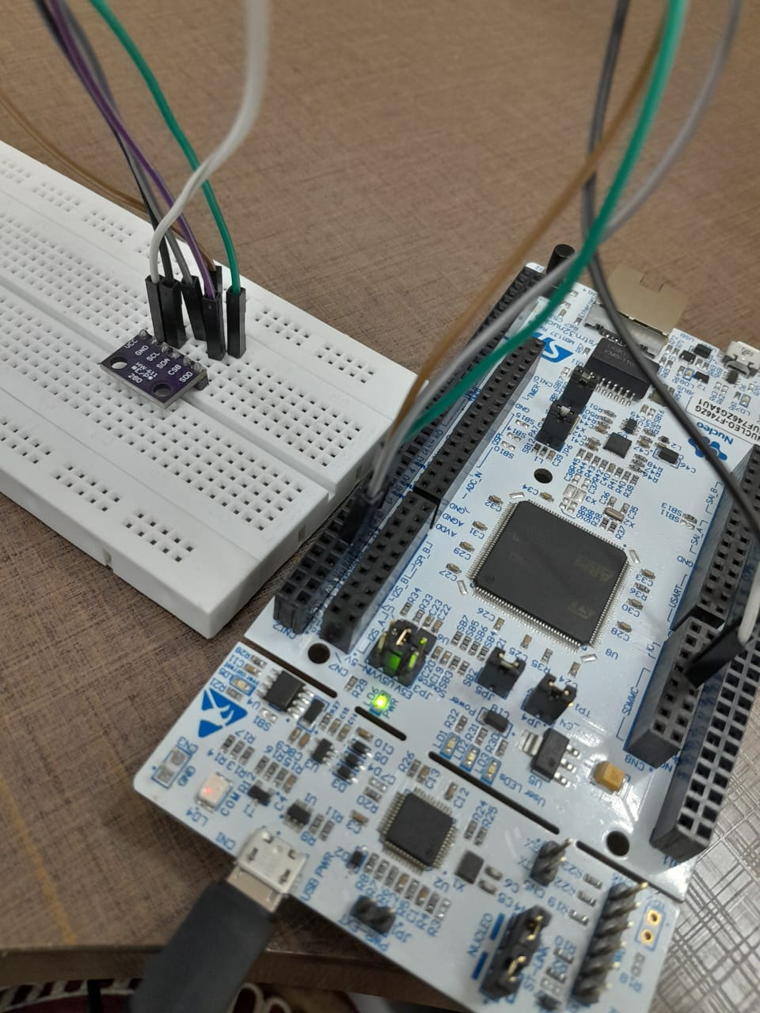
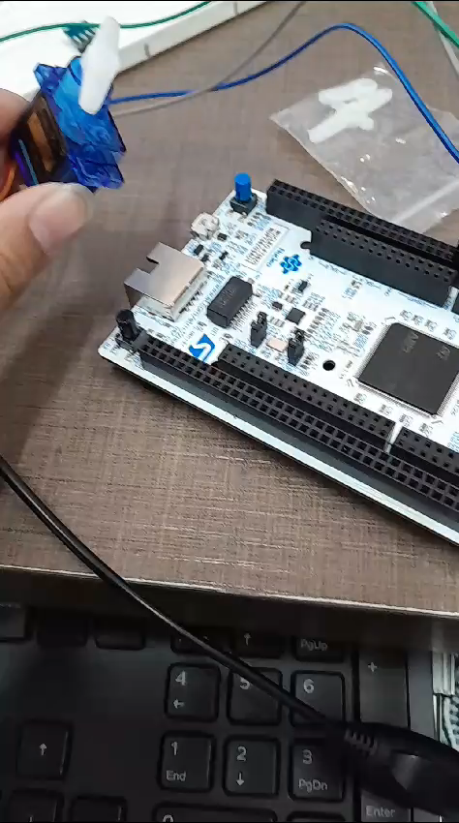
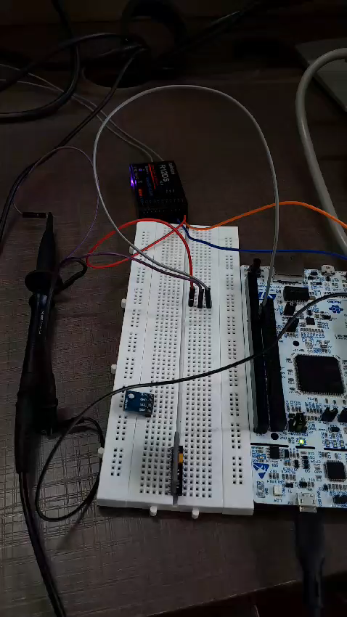
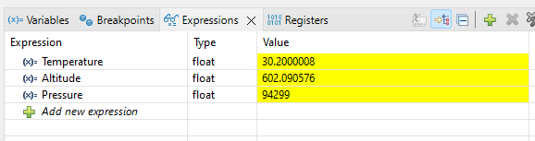
WORK DONE
Integration of BMP280/180
Integration of Servo
Integration of RC Controller

Slide 6
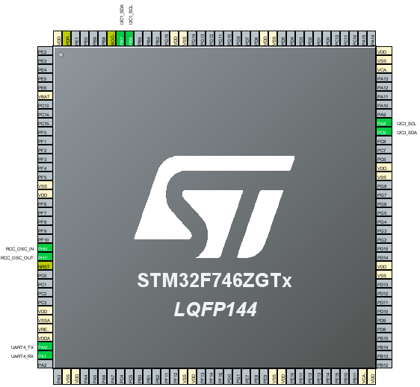
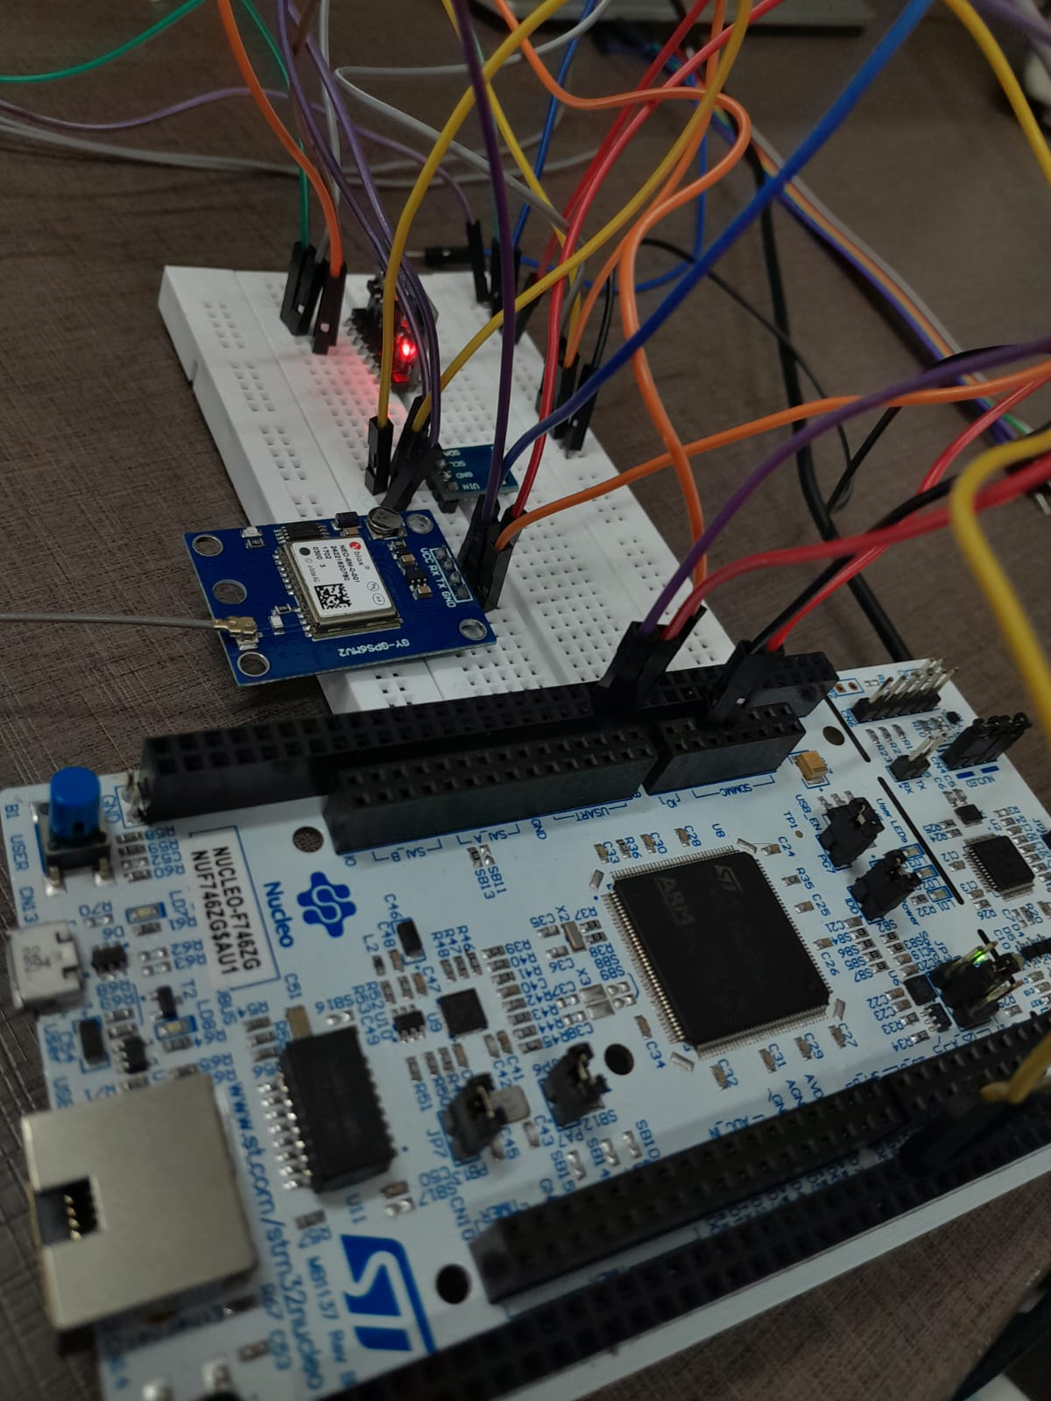
WORK DONE
All sensors on one Board

